Slide 1
Requirement Prioritization
By: Fariha Shaikh

Slide 2
Decision-Making Process:
The decision-making process is a step-by-step approach used to identify and choose the best course of action from several alternatives to achieve a desired outcome.
It is a systematic method that helps individuals or teams analyze options, evaluate outcomes, and make informed choices.
In everyday life we make a decision like buying a car, a telephone, food etc.
Usually, we do not have more than a couple of choices to consider. Decision can be difficult to make with less couple of choices.

Slide 3
Example:
A student is deciding how to spend their afternoon:
Option 1: Study for an upcoming exam, which will improve grades but takes a lot of time and effort.
Option 2: Work on a personal project, which is fun but not urgent.
Option 3: Go out with friends, which is relaxing but won’t help with schoolwork.
To make the best decision, the student needs to prioritize based on factors like exam deadlines, personal goals, and well-being.

Slide 4
Need of Prioritization:
When having tens, hundreds, or even thousands of alternatives, decision-making becomes much more difficult.
One of the keys to making the right decision is to prioritize between different alternatives. It is often not obvious which choice is better, because several aspects must be taken in consideration.

Slide 5
Example
A small business owner is deciding how to use their limited marketing budget:
Option 1: Invest in social media ads, which could reach a large audience but may not lead to immediate sales.
Option 2: Sponsor a local event, which could build community relationships but has a smaller reach.
Option 3: Offer discounts to current customers, which could boost immediate sales but might reduce profit margins.
The business owner must prioritize based on factors like return on investment (ROI), customer engagement, and long-term growth goals.

Slide 6
Requirement Prioritization:
It is the process of ranking and organizing requirements based on their importance to decide their order of implementation.
It ensures that the most critical and valuable features are developed and delivered first, aligning with business goals, resource constraints, and stakeholder needs.
The functionality that is most important for the customers might not be as important when other aspects (eg: price) are factored in
We need to develop the functionality that is most desired by the customers, as well as least risky, least costly, and so forth

Slide 7
Prioritization Process:
It's an iterative process and might be performed with different information in different phases during the software lifecycle.
Prioritize techniques can be divided into two categories:
Methods
Negotiation approaches

Slide 8
Methods:
Methods involve assigning numerical values to different aspects of requirements, such as importance, cost, or risk, to help prioritize them objectively.
Quantitative methods help combine different factors into one clear assessment, making decisions faster and easier.

Slide 9
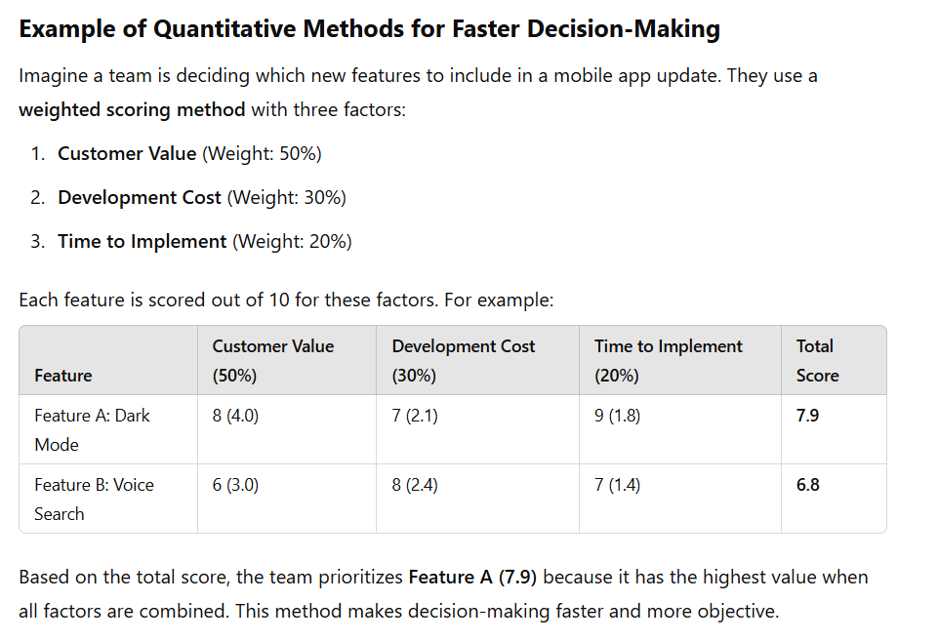

Slide 10
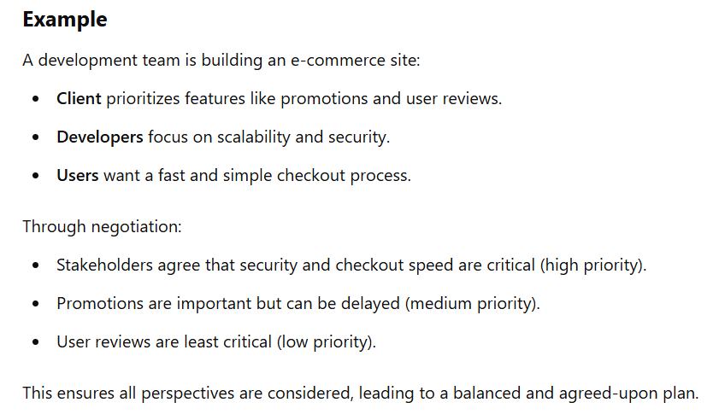
Negotiation Approach:
Focus on giving priorities to requirements by reaching agreement between different stakeholders.
Based on subjective
measures.

Slide 11
Techniques:
MoSCow Method Categorizes requirements into: Must Have: Essential requirements that are non-negotiable. Should Have: Important but not critical. Could Have: Desirable but optional. Won’t Have: Requirements to be deferred or dropped.
Kano Model: Classifies requirements based on customer satisfaction
100-Dollar Method: Stakeholders are given a budget (e.g., $100) to distribute across requirements, indicating their importance.
Value vs. Complexity Matrix:prioritize high-value, low-complexity items first.
Analytical Hierarchy Process (AHP): Compares requirements pairwise to calculate their relative priorities systematically.

Slide 12
Importance:

